Slide 1



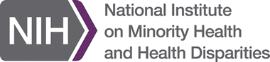
Diagnóstico Genómico de Enfermedades Raras
Genomic diagnosis of rare disease

Slide 2
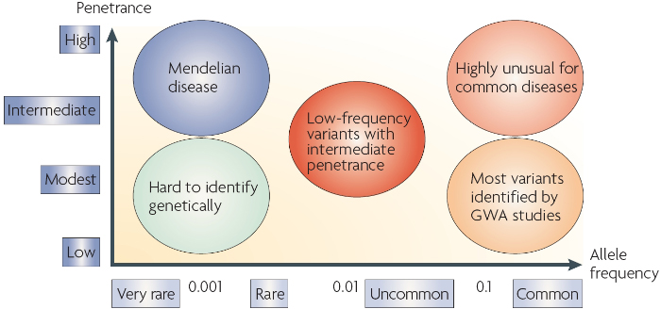
https://www.nature.com/scitable/topicpage/multifactorial-inheritance-and-genetic-disease-919/

Slide 3
Sources of human genetic variation
All human genetic (genomic) variation arises from mutation
Mutations are changes in DNA - variants
Once DNA is mutated (changed), those variants can be inherited and spread in the population (i.e. become polymorphisms)
There are different types of mutation
We will go back to Nature SciTable for this
https://www.nature.com/scitable/topicpage/genetic-mutation-441/

Slide 4
Consequences of human genetic variation
By consequences here, I am referring to “first-order” consequences with respect to the effect of genetic variation on proteins
Proteins are the molecular intermediate through which genetic variants impact phenotype
This is overly simplistic since non protein-coding variants can also impact function (e.g. miRNAs or long non-coding RNAs)
At this time, less in known about the phenotypic consequences of non protein-coding variants

Slide 5
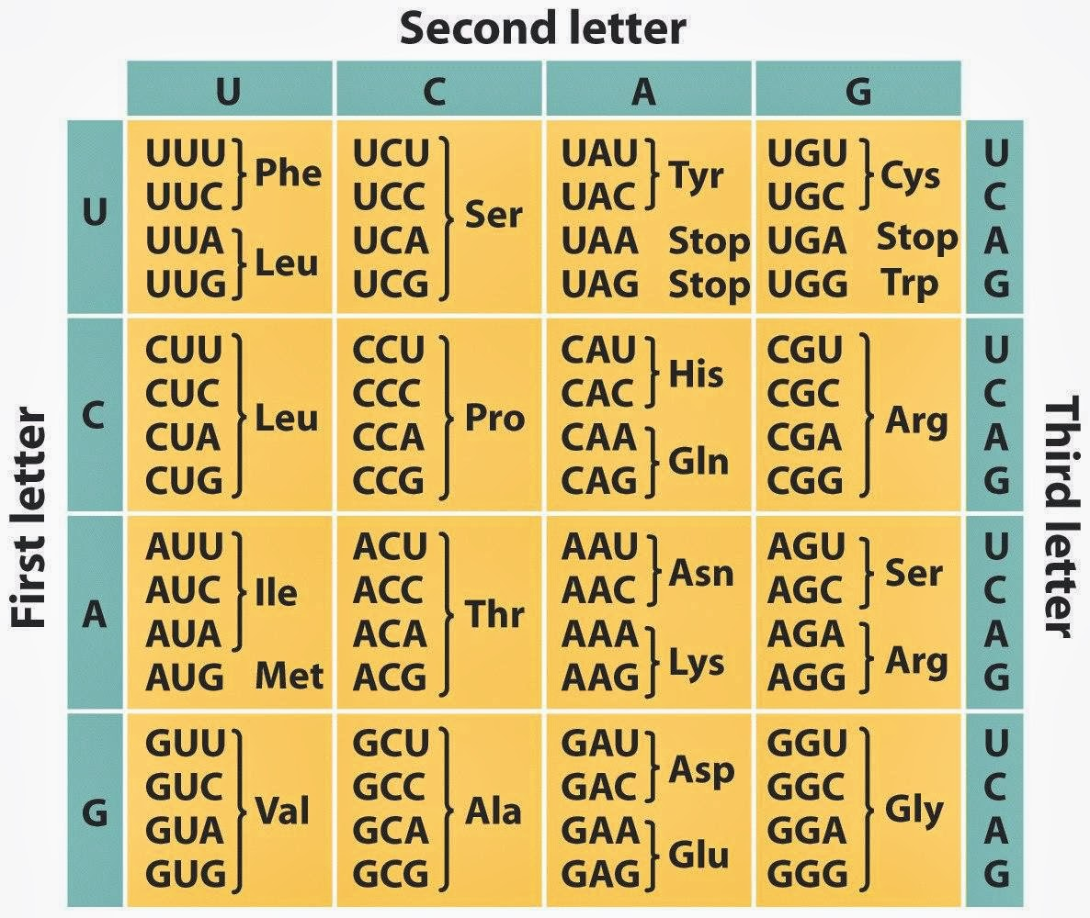
Redundancy of the genetic code* *different codons can encode the same amino acid

Slide 6
Types of point mutations
Synonymous mutations (substitutions) are changes in DNA that DO NOT change the encoded amino acid
Also called silent mutations
Nonsynonymous mutations (substitutions) are changes in the DNA to DO change the encoded amino acid
Missense change the encoded amino acid
Nonsense introduce a stop codon
Frameshift (short indels) change frame, which typically introduces a stop codon nearby downstream

Slide 7
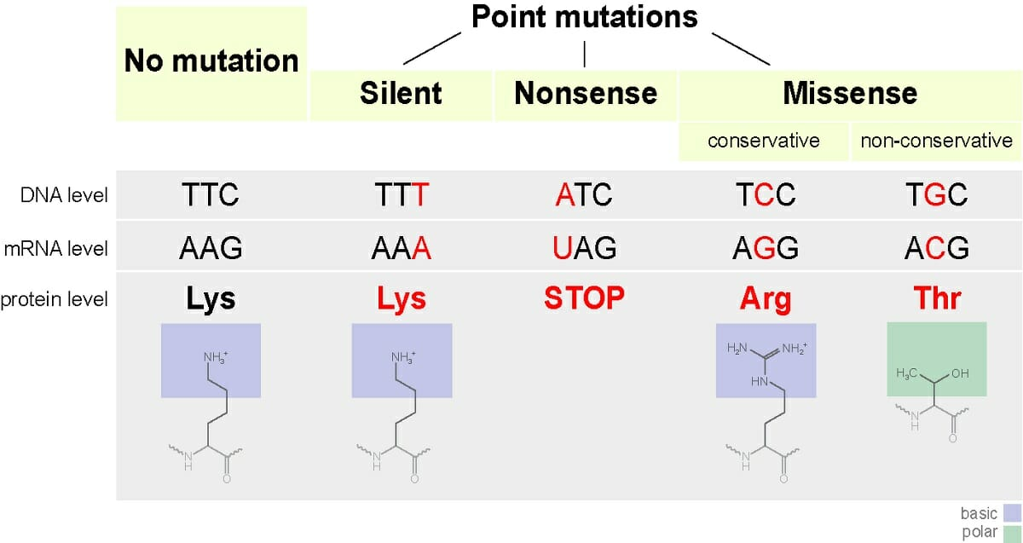
Types of point mutations

Slide 8
Loss and gain of function mutations
Missense and nonsense mutations can lead to reduced or lost protein function
Loss of function mutations tend to be recessive
Loss of function mutations are more common in disease
But rare in populations as they are selected against
Computationally predicted as mutations that: (1) introduce a pre-mature stop codon, (2) cause a frameshift, or (3) alter essential splice sites
Missense mutations can confer enhanced activity on proteins
Gain of function mutations tend to be dominant
Gain of function mutations are rare in disease and populations

Slide 9
Now that we understand (1) the sources of human genetic variation and (2) the first-order consequences of human genetic variation, how can we drill down to understand the clinical implications of human genetic variation
In other words, how do you know which mutations (may) cause* which diseases
*Since we are dealing with rare and penetrant variants for monogenic (Mendelian) diseases, we are assuming causality (although some may be associations)

Slide 10

ClinVar
Publicly accessible resource for Clinically relevant variants
Works by community submissions to the database with supporting evidence for clinical relevance
Classifies variants as one of four classes:
Benign
Likely benign
Variant of unknown significance
Likely pathogenic
Pathogenic
https://www.ncbi.nlm.nih.gov/clinvar/

Slide 11
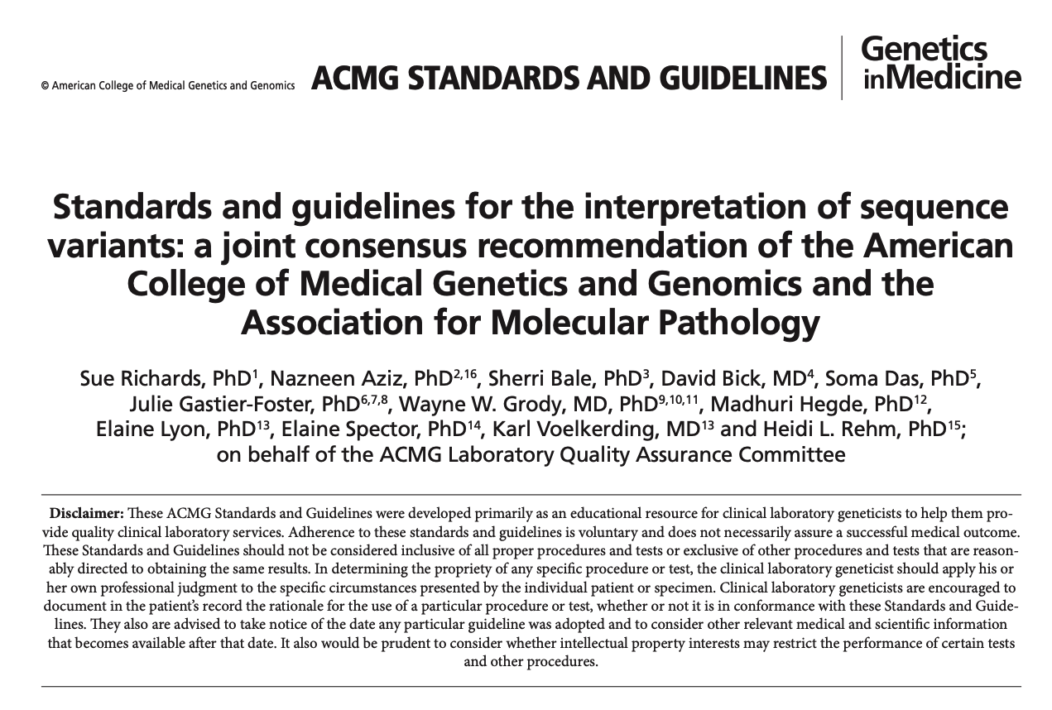

Slide 12
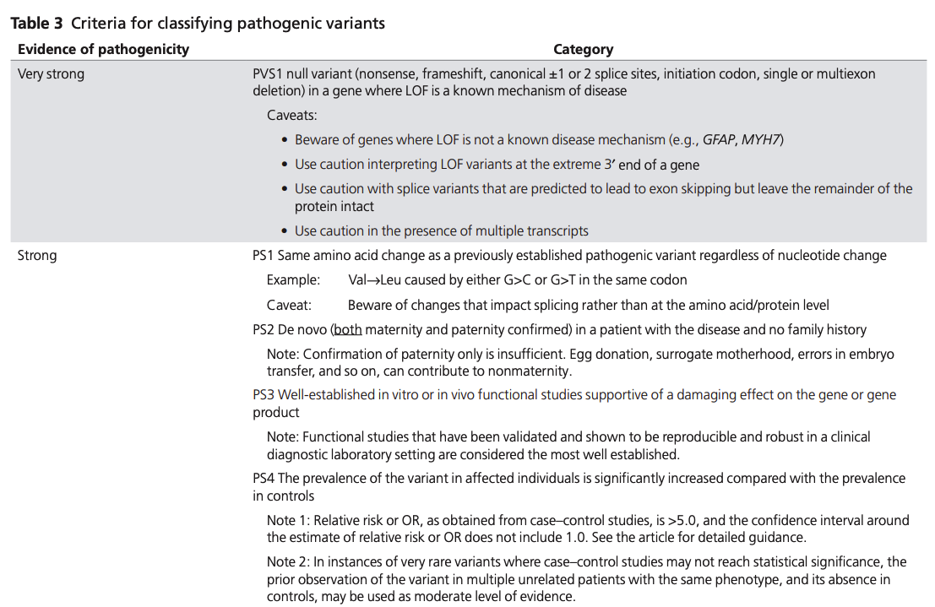

Slide 13
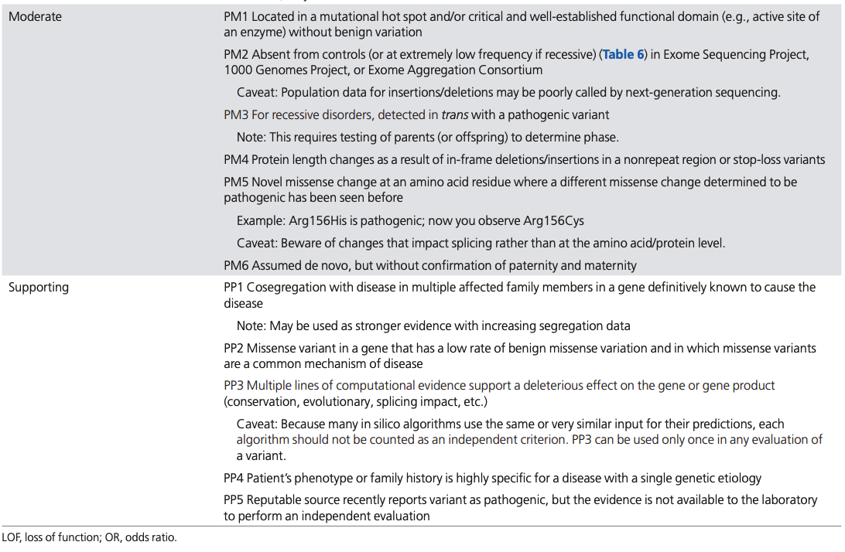

Slide 14
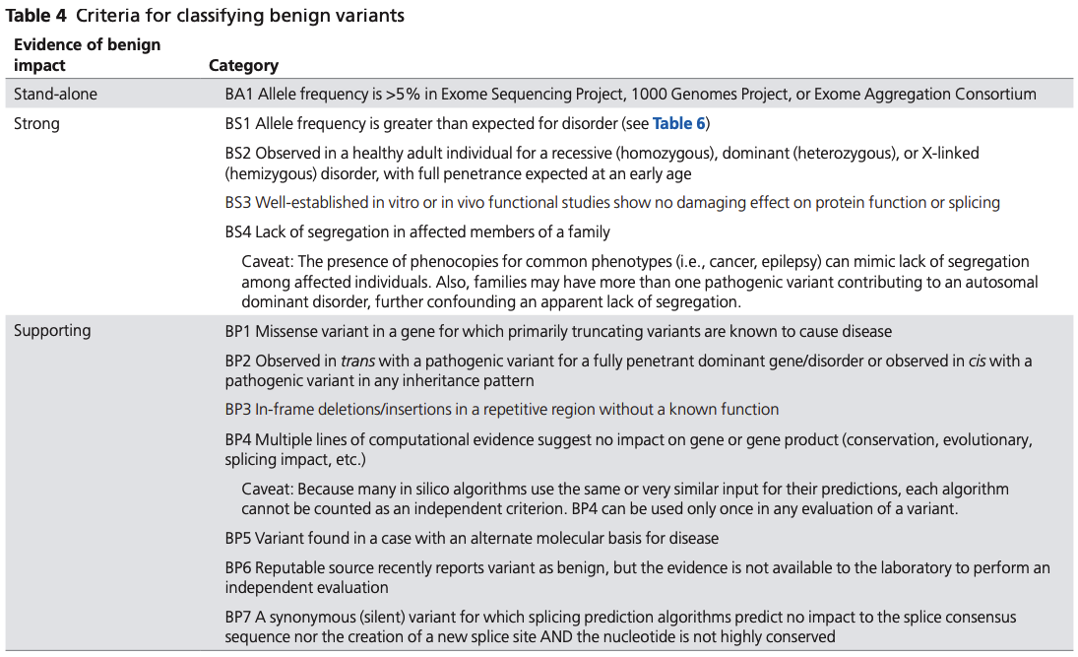

Slide 15
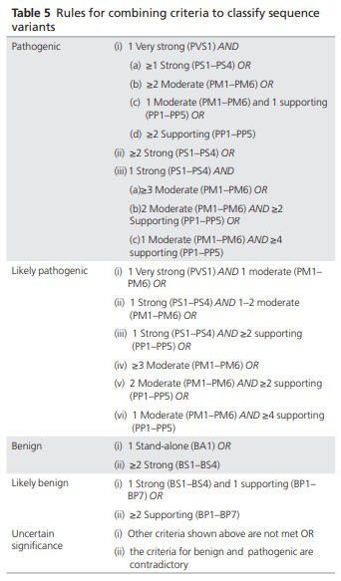

Slide 16
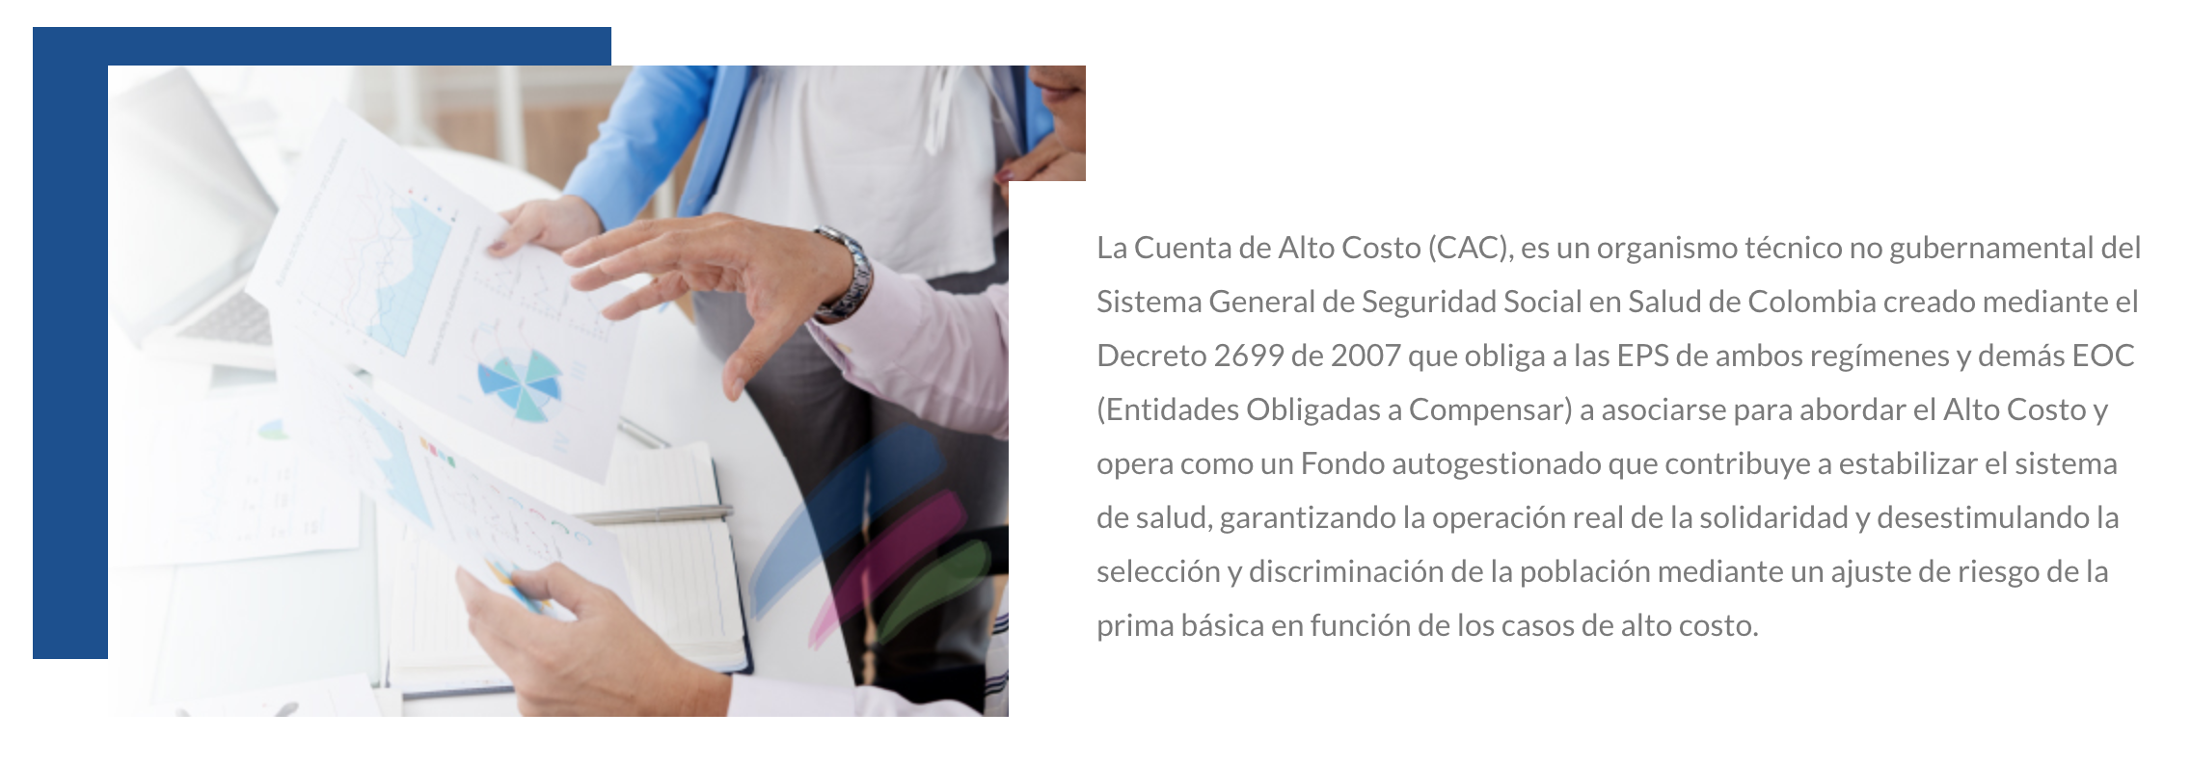
Cuenta de Alto Costo
https://cuentadealtocosto.org/site/quienes-somos/

Slide 17
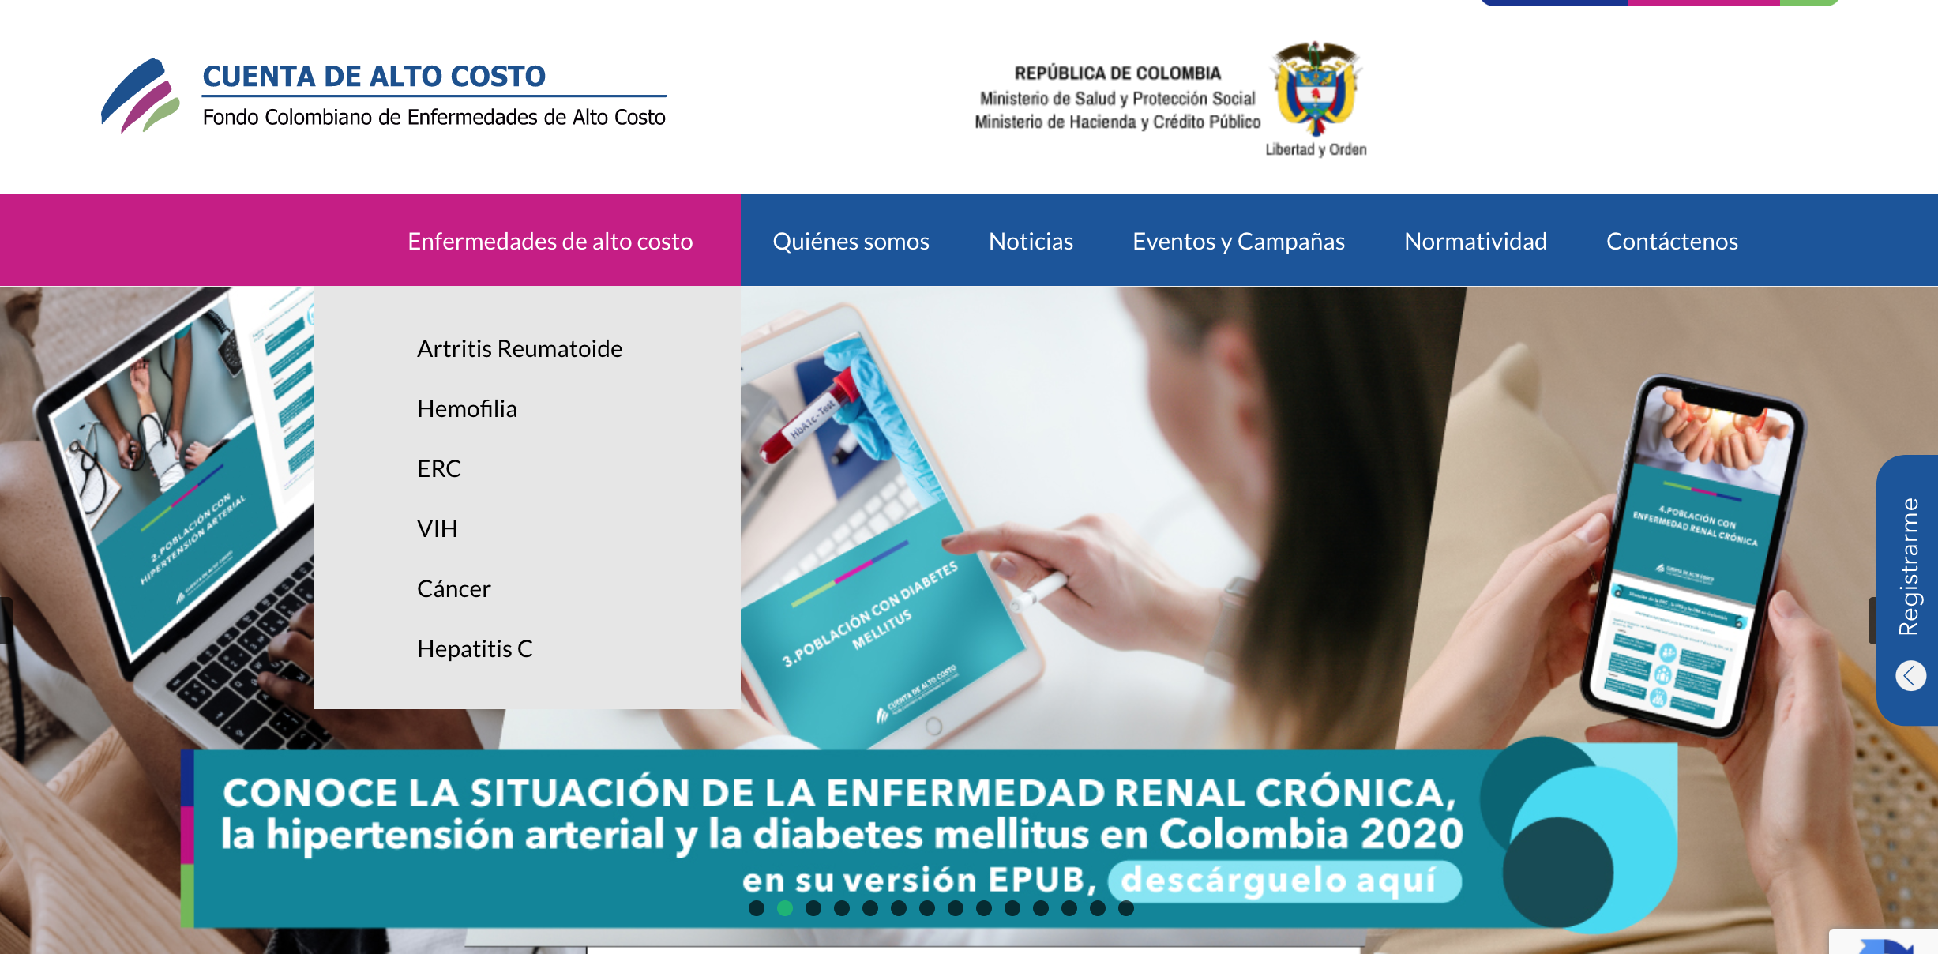

Slide 18

Case study
Patient Name: John Doe
Symptoms:
Excessive bleeding
Large bruises
Joint pain

Slide 19
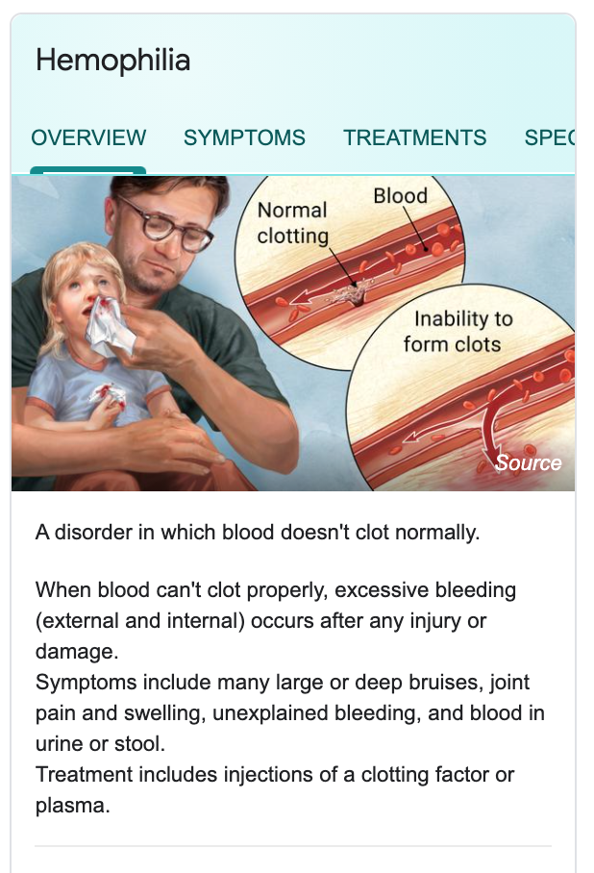
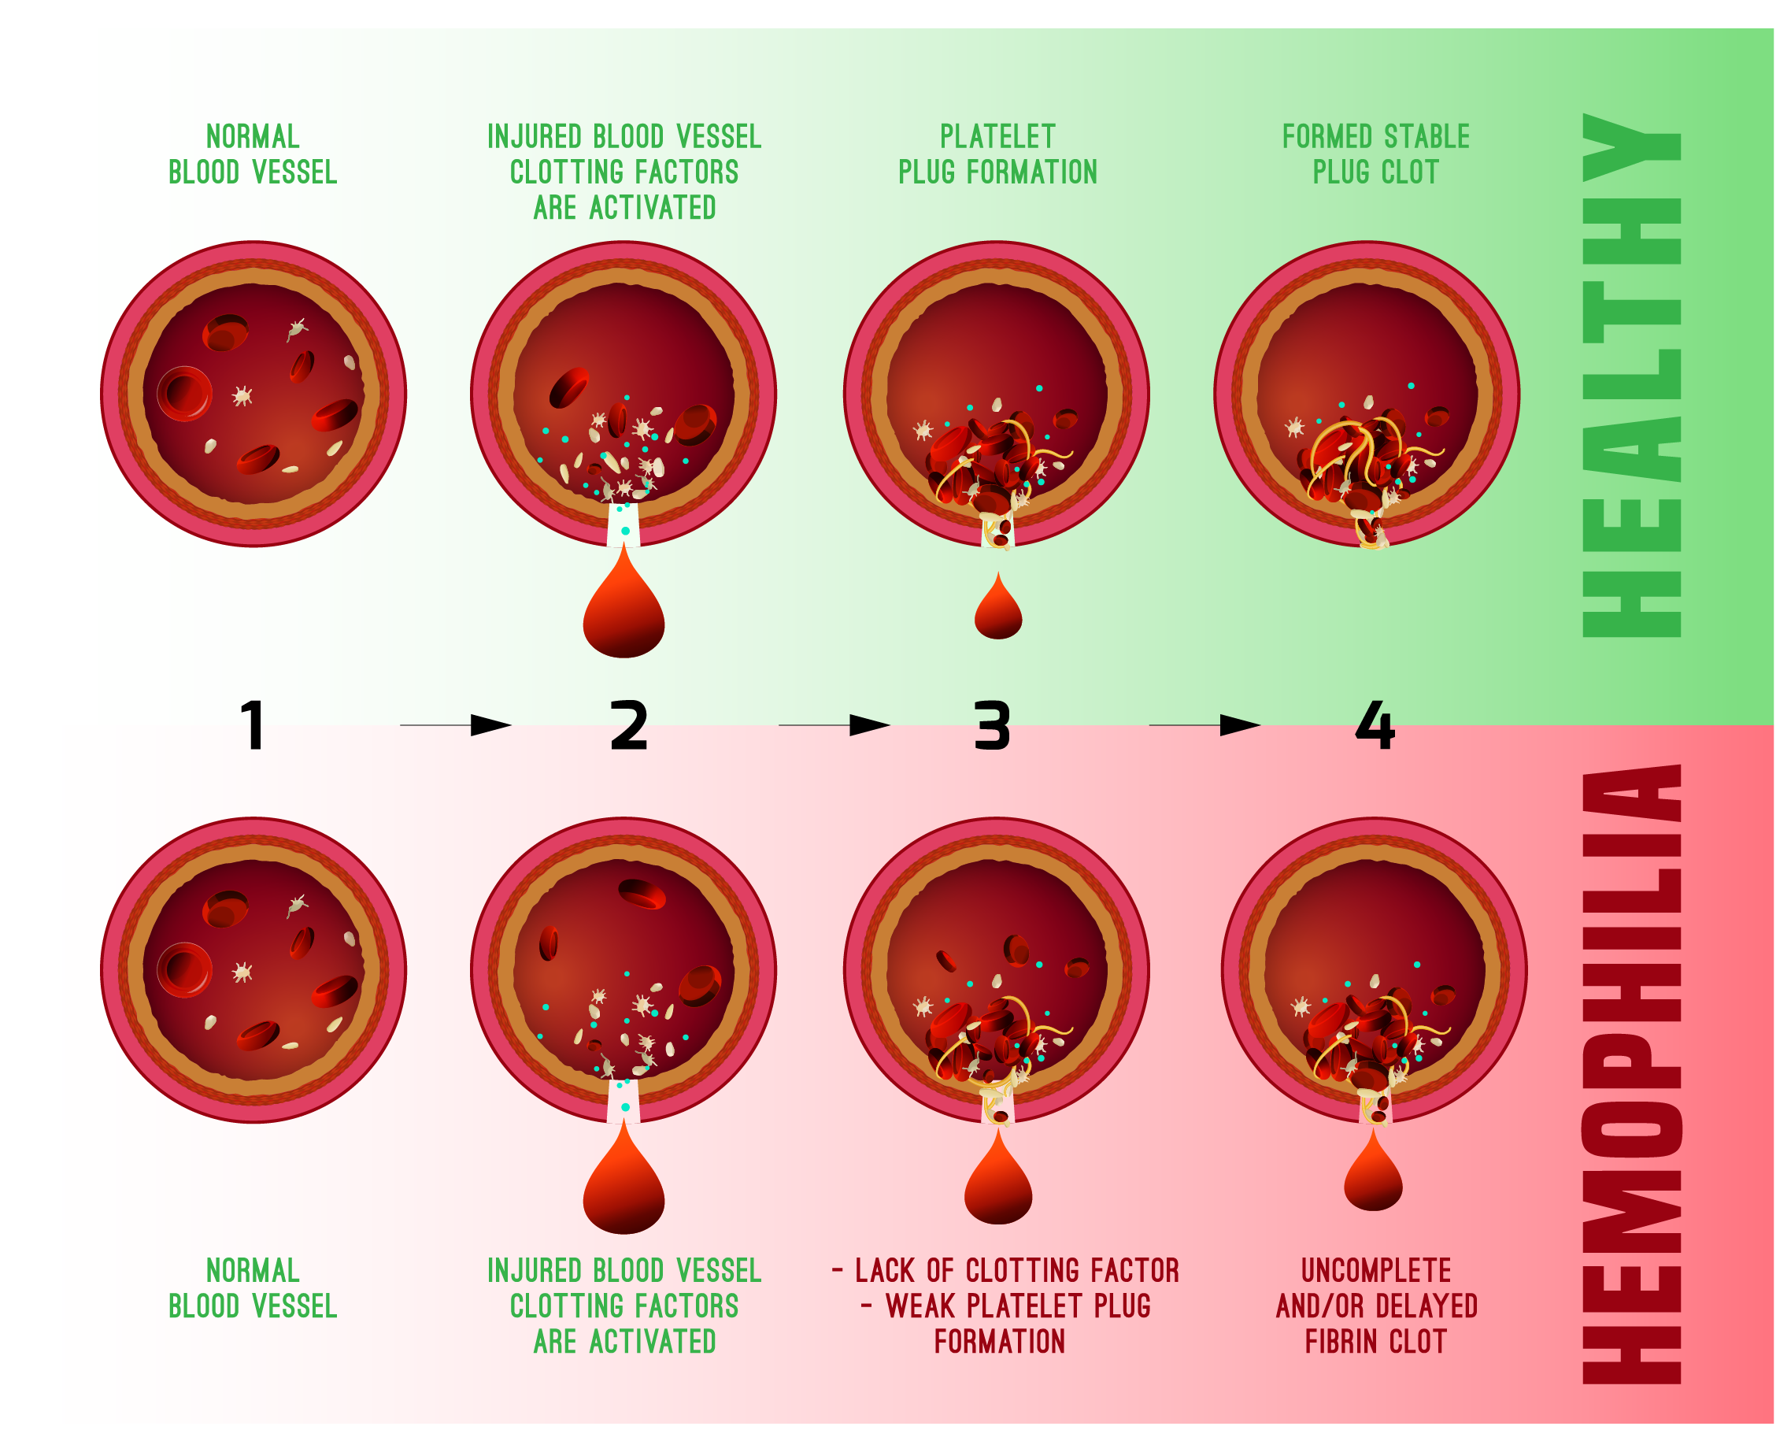
Case study
Preliminary diagnosis: Hemophilia

Slide 20
Case study
Next step:
Confirm diagnosis using genomics

Slide 21
Additional resources
ACMG Guidelines: https://pubmed.ncbi.nlm.nih.gov/25741868/
https://varsome.com/
https://www.ncbi.nlm.nih.gov/clinvar/

